Slide 1
Deployment Diagram

Slide 2
What is Deployment Diagram
A deployment diagram is a UML diagram type that shows the execution architecture of a system, including nodes such as hardware or software execution environments, and the middleware connecting them.
Deployment diagrams are typically used to visualize the physical hardware and software of a system. Using it you can understand how the system will be physically deployed on the hardware.
Deployment diagrams help model the hardware topology of a system compared to other UML diagram types which mostly outline the logical components of a system.

Slide 3
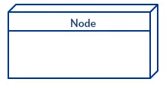
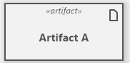
Deployment Diagram Notations / Elements
Nodes :
A node, represented as a cube, is a physical entity that executes one or more components, subsystems or executables. A node could be a hardware or software element. Ex : IDEs.
Artifacts:
Artifacts are concrete elements that are caused by a development process. Examples of artifacts are libraries, archives, configuration files, executable files etc.

Slide 4
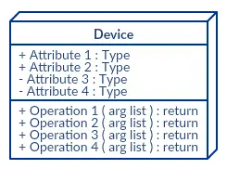
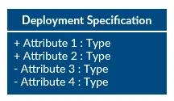
Cont.
Devices :
A device is a node that is used to represent a physical computational resource in a system. An example of a device is an application server.
Deployment Specifications
Deployment specifications is a configuration file, such as a text file or an XML document. It describes how an artifact is deployed on a node.

Slide 5
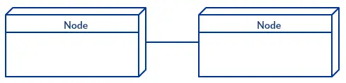
Communication Association
Deployment Diagram Communication Path
This is represented by a solid line between two nodes. It shows the path of communication between nodes.

Slide 6
How to Draw a Deployment Diagram
Step 1: Identify the purpose of your deployment diagram. And to do so, you need to identify the nodes and devices within the system you’ll be visualizing with the diagram.
Step 2: Figure out the relationships between the nodes and devices. Once you know how they are connected, proceed to add the communication associations to the diagram.
Step 3: Identify what other elements like components, active objects you need to add to complete the diagram.
Step 4: Add dependencies between components and objects as required.

Slide 7
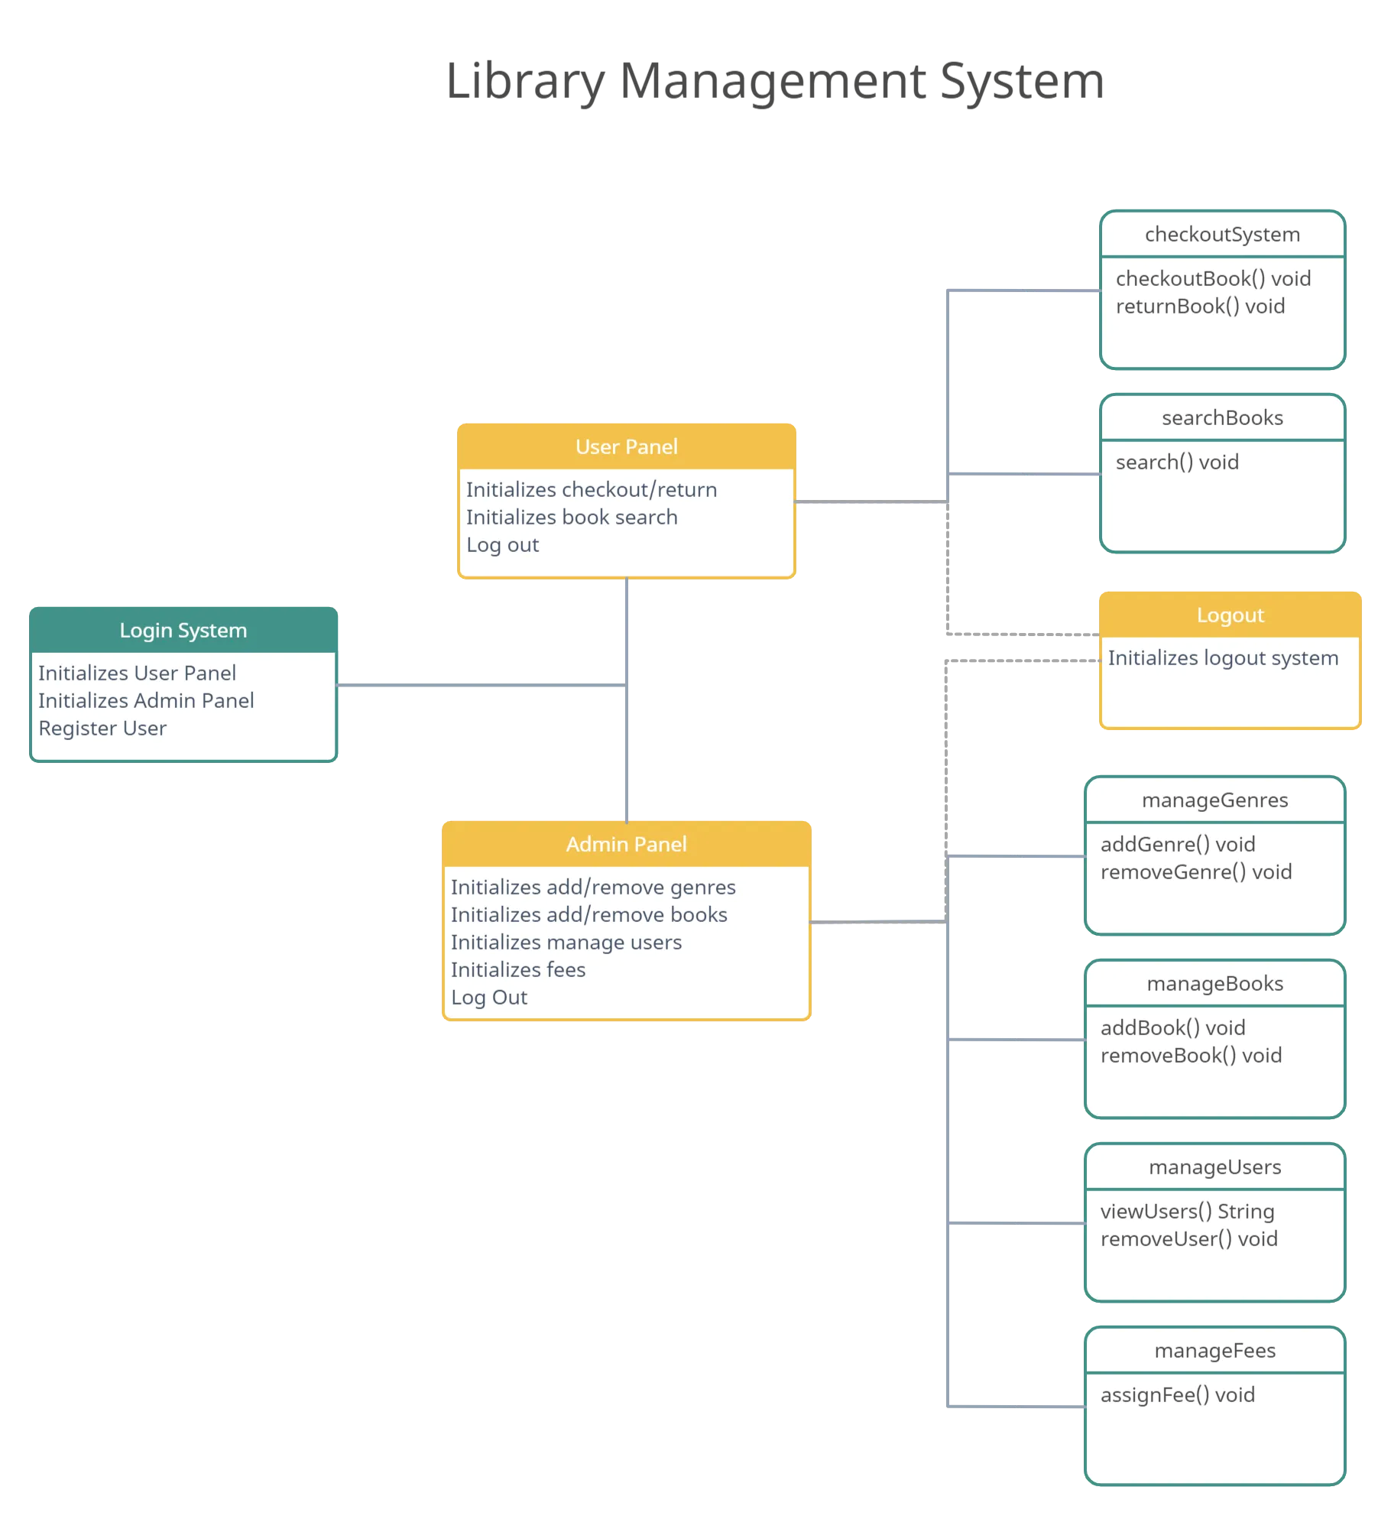
Example

Slide 8
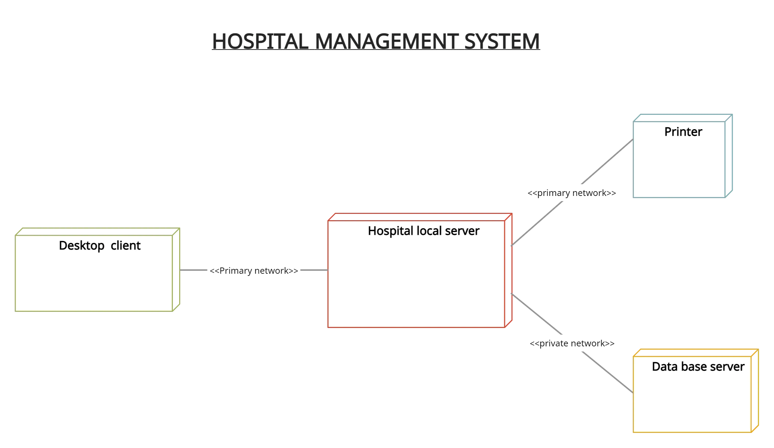
Example 2

Slide 9
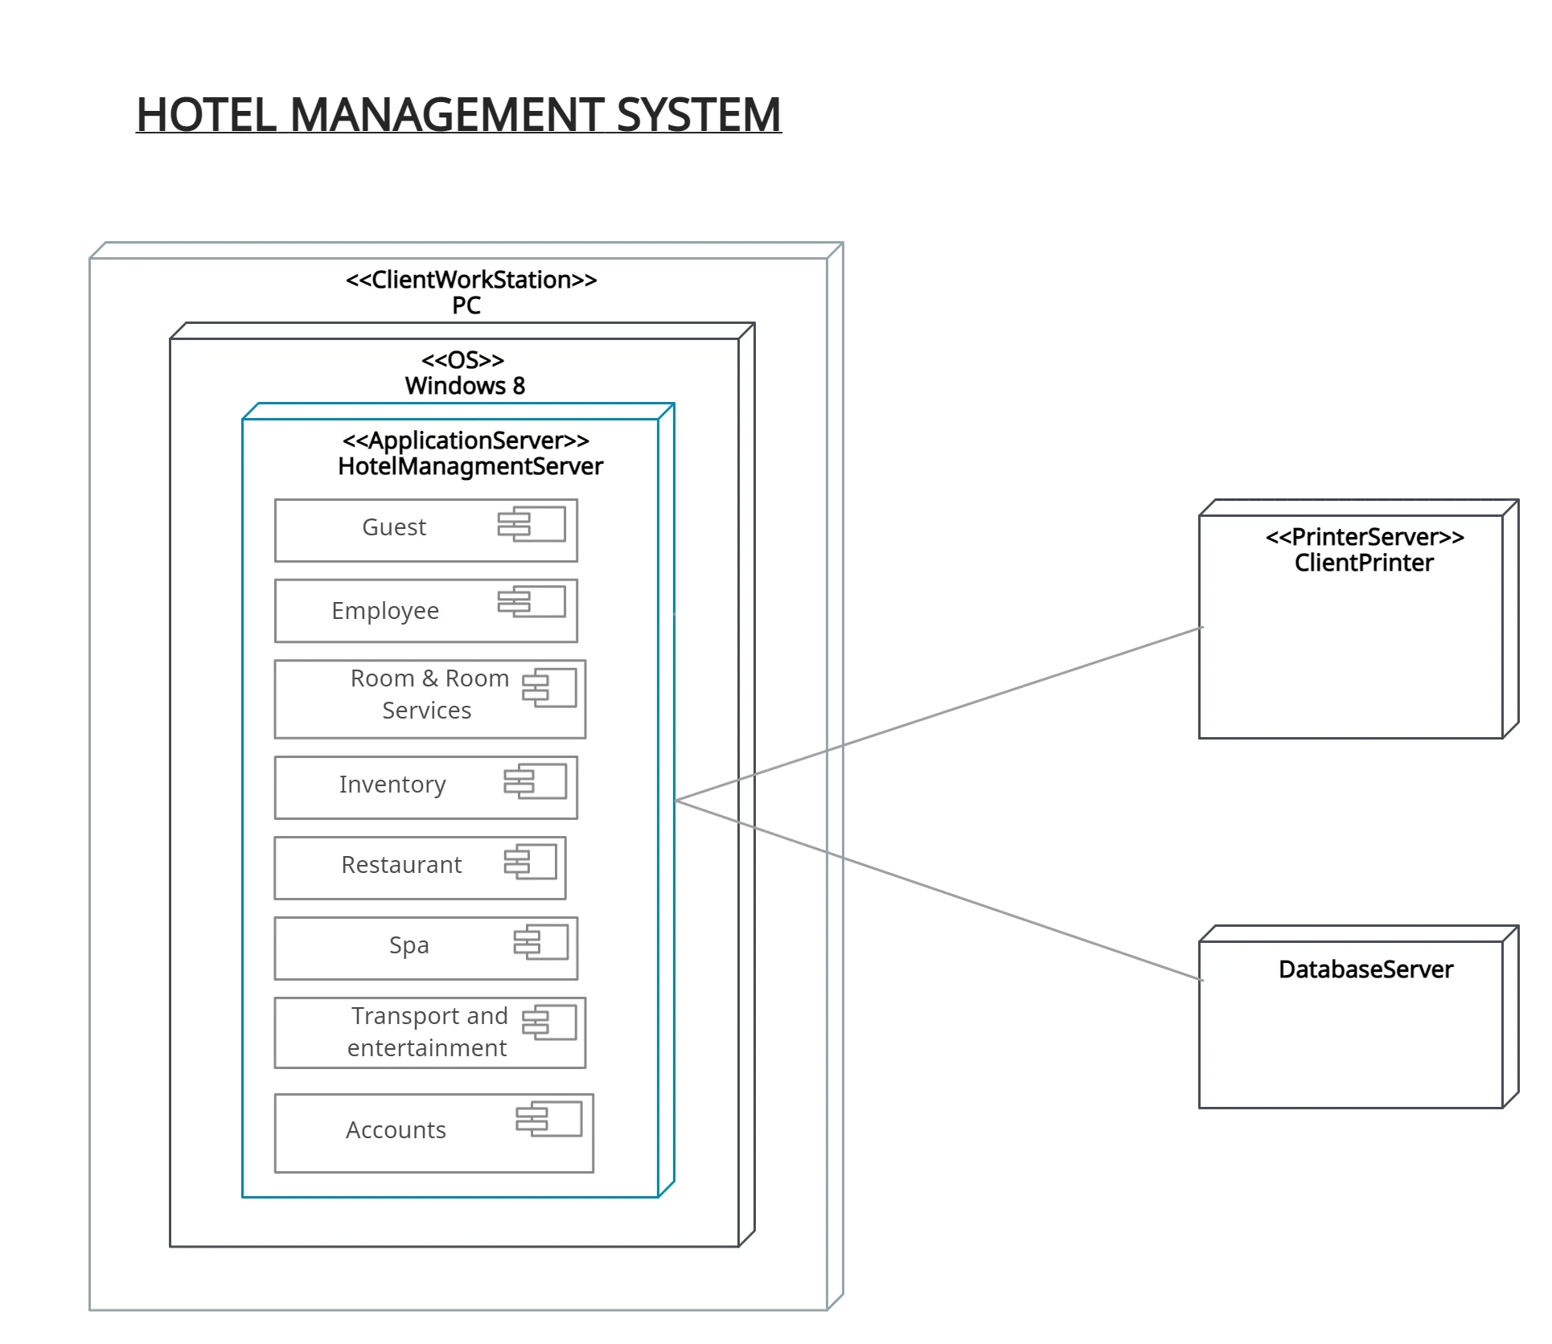
Example 3

